Slide 1


Symmetric Encryption
👂🏼

Slide 2



Symmetric Encryption

Slide 3
AES – Advanced Encryption Standart
1998

Slide 4
AES – Advanced Encryption Standart
AES-128 // 10 iterations
AES-192 // 12 iterations
AES-256 // 14 iterations
AES-i → i refers to the length of the key.

Slide 5

AES – Advanced Encryption Standart
m (128 bit)
AES
C (128 bit)
Key (128/192/256 bit)

Slide 6
AES
Each message is a size of 128 bits devided into 4X4 matrix – 16 bytes
Each cell is 1 byte (8 bits) → 4X4X8 = 128
Each iteration has its own key Ki
We get the key be expansion of the init key
Each iteration has 4 steps:
subBytes
shiftRows
mixCols
addRoundkey
In the last iteration we do 1,2,4 steps
1 byte

Slide 7
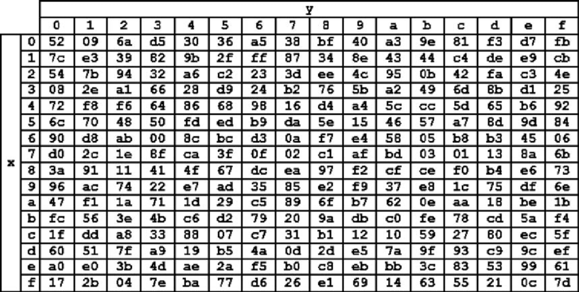
Sub bytes
Apply the S-box for each byte
byte (8 bit)
S-BOX
byte (8 bit)

Slide 8
Shift Rows
For each row i, we shift left i places.

Slide 9
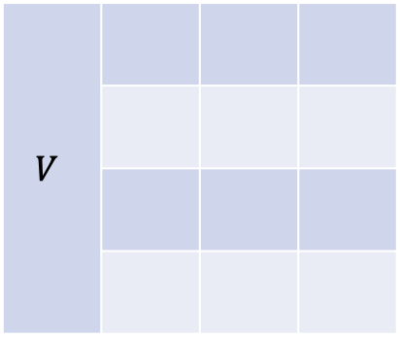


Mix Columns
Each column, will be multiple by a C matrix.
$C ∈M_{4×4}$
$$V$$
$$CV$$

Slide 10
Add Round Key
XOR: $M_{i}⊕K_{i}$

Slide 11
A single bit effects all
*
*
ARK
S-Box
Shift Rows
Mix Cols
ARK+S-box
Shift Rows
Mix Cols

Slide 12
AES – Advanced Encryption Standart
m (128 bit)
AES
C (128 bit)
Key (128/192/256 bit)

Slide 13
AES today
Commanly used
S3 bucket
HTTPS symmetric key communication
Soc2

Slide 14
Long messages encryption (AES)
We want to encrypt a long message by AES
Let’s give it a try (a simple way)
m
m (128 bit)
AES
C (128 bit)
m (128 bit)
AES
C (128 bit)
m (128 bit)
AES
C (128 bit)
m (128 bit)
AES
C (128 bit)
m (128 bit)
AES
C (128 bit)
m (128 bit)
AES
C (128 bit)
Key (128/192/256 bit)
Key (128/192/256 bit)
Key (128/192/256 bit)
Key (128/192/256 bit)
Key (128/192/256 bit)
Key (128/192/256 bit)
c

Slide 15



Why it’s not safe?
$M_{0}=m_{0}m_{1} →AES →c_{0}c_{1}$
$M_{1}=m_{0}m_{2} →AES →c_{0}c_{2}$
Let’s try to fix it - let’s try to fix every block
m
m (128 bit)
AES
C (128 bit)
$$1 ⨁$$
m (128 bit)
AES
C (128 bit)
$$2 ⨁$$
Key (128/192/256 bit)
Key (128/192/256 bit)
c

Slide 16

Why it’s not safe?
$M_{0}=m_{0}m_{1} →AES →c_{0}c_{1}$
$M_{1}=m_{0}m_{2} →AES →c_{0}c_{2}$
These methods are deterministic!

Slide 17
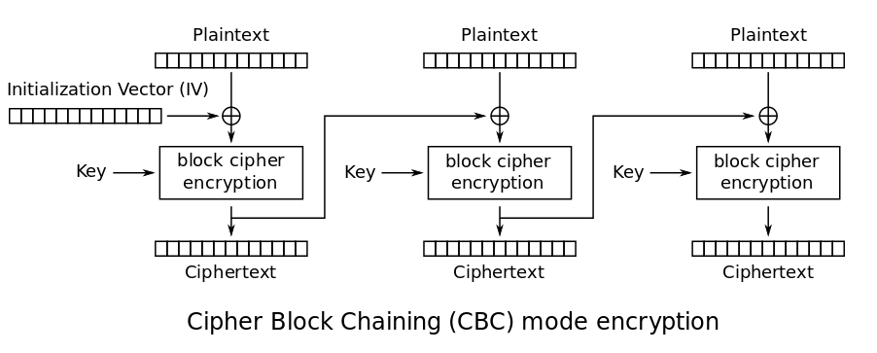
AES – cipher block chaining

Slide 18
AES – cipher block chaining
Pros:
Harder to crack
Cons:
Synced
If we get error in one step it effects the following

Slide 19
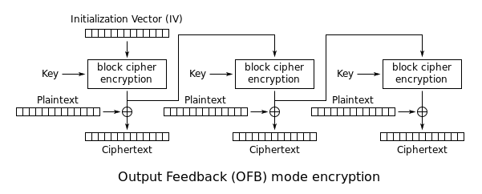
AES – output feedback mode
IV

Slide 20

AES – output feedback mode
Pros:
An error in one step will not effect the rest
Pre-calculation
Cons:
Synced
If we use the same IV, it could be risky:
$C_{1}=IV,\left(z_{1}⊕m_{1}\right),z_{2}⊕m_{2}$
$C_{2}=IV,\left(z_{1}⊕{m`}_{1}\right),z_{2}⊕{m`}_{2}$
$C_{1}⊕C_{2}=0…0, m_{1}⊕m`_{1}, m_{2}⊕m`_{2}$

Slide 21
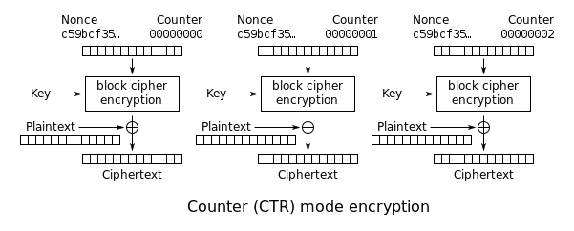
AES – counter mode (a common usage)

Slide 22

AES – counter mode
Pros:
An error in one step will not effect the rest
Pre-calculation of encrypted counters
Asynced
Cons:
If we use the same IV(aka nonce), it could be risky:
$C_{1}=IV,\left(z_{1}⊕m_{1}\right),z_{2}⊕m_{2}$
$C_{2}=IV,\left(z_{1}⊕{m`}_{1}\right),z_{2}⊕{m`}_{2}$
$C_{1}⊕C_{2}=000…000, m_{1}⊕m`_{1}, m_{2}⊕m`_{2}$

Slide 23
Symmetric Encryption
👂🏼
Sniffing attack

Slide 24

AES – authentication
😈👹
Let’s say we encrypted a file and sent it encrypted
How can we ensure we decrypt the right file and not some malicious code?
Authentication!

Slide 25
AES – GCM
m (X bits)
AES GCM
C (X bits) + tag
Key (128/192/256 bit)

Slide 26
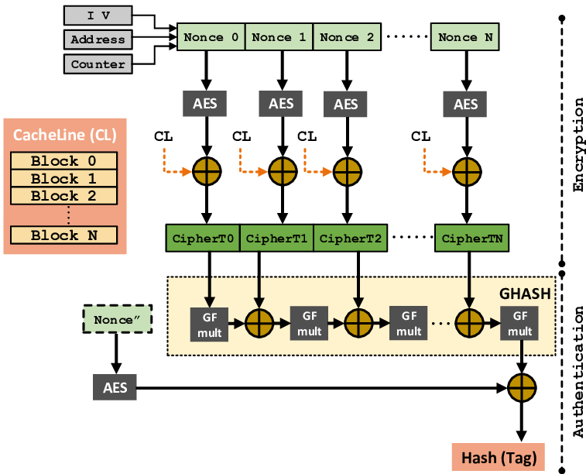
AES – Galois/Counter Mode - GCM

Slide 27
AES – GCM – extend it
M ➔ split to n chunks
m (X bits)
AES
C (X bits) + tag
m (X bits)
AES
C (X bits) + tag
m (X bits)
AES
C (X bits) + tag
m (X bits)
AES
C (X bits) + tag
...........
Key (128/192/256 bit)
Key (128/192/256 bit)
Key (128/192/256 bit)
Key (128/192/256 bit)
C, |C| = |M| + n * |tag|
❌ The cipher message will be much bigger than needed
❌ Each chunk will be authenticated but not the combination of them → we’ll have to add authentication anyways

Slide 28
What can we do?
✅ Implement the enc/dec with CTR + authentication
✅ Read the file using offset instead of loading it all
DEMO
Cipher GCM | Our GCM (CRT+Authemtication)
Load the whole file to the memory | Read the file with position
Open and Seal (passing by value) | Control memory allocation within the code (work with passing by reference)

Slide 29
AES – GCM – extend it
M ➔ split to n chunks
m (X bits)
C (X bits)
CTR
m (X bits)
C (X bits)
CTR
m (X bits)
C (X bits)
CTR
m (X bits)
C (X bits)
CTR
...........
Key (128/192/256 bit)
Key (128/192/256 bit)
Key (128/192/256 bit)
Key (128/192/256 bit)
Auth
C, |C| = |M| +|tag|

Slide 30
AES – counter mode (a common usage)

Slide 31



Encrypt
Random IV
Cipher text
Plain text
AES CTR
HASH

Slide 32

Decrypt
IV
Chunk - 0
Tag - 0
…. ….
Chunk - i
Tag - i
…. ….
Chunk - m
Tag - m
HASH
Cipher text
== ?
FALSE
Plain text
TRUE
AES CTR

